Slide 1

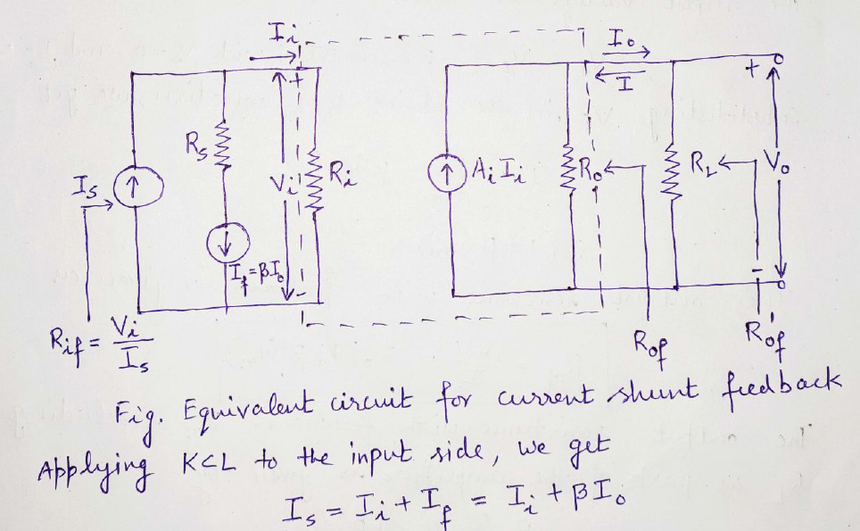

Slide 2
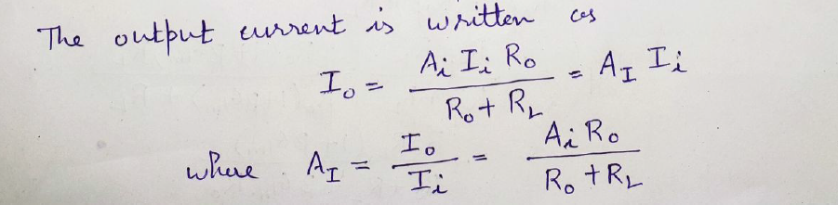
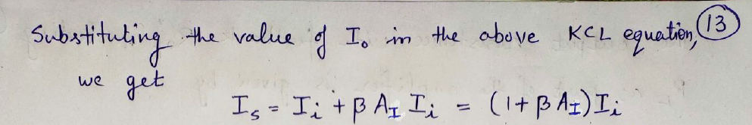

Slide 3
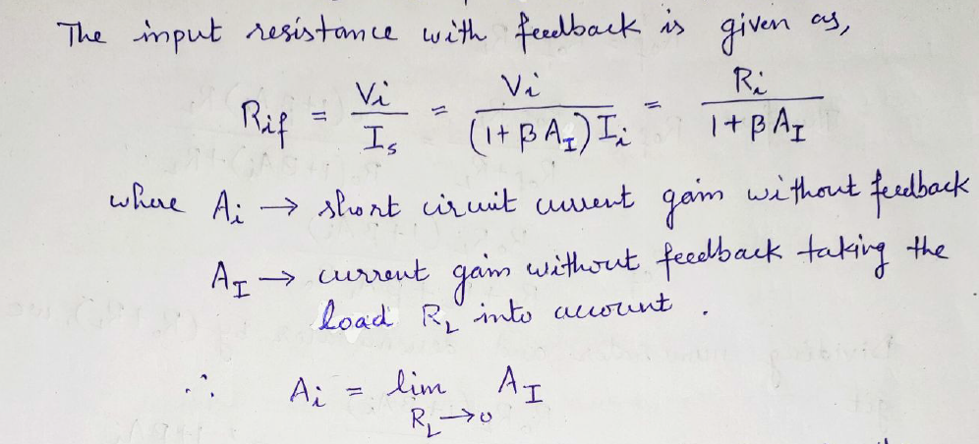

Slide 4
In case of current-shunt feedback amplifier, the input resistance of the amplifier with negative feedback is given as
A. R_{if} = R_{i} (1+ A_{I})
B. R_{if} = R_{i} (1+ β A_{I})
C. R_{if} = R_{i} /(1+β A_{I})
D. R_{if} = R_{i} (1+ β)

Slide 5
Answer : C

Slide 6
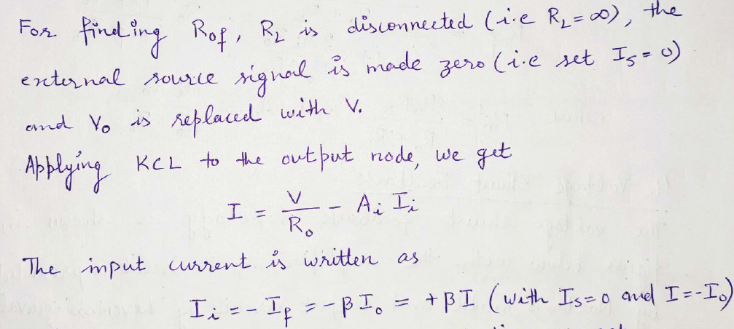

Slide 7
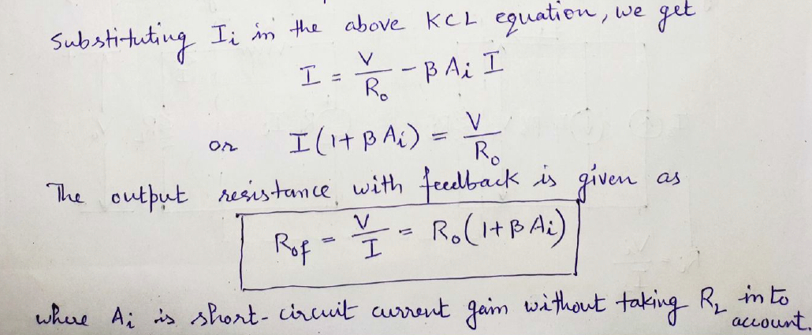

Slide 8
In case of current-shunt feedback amplifier, the output resistance of the amplifier with negative feedback is given as
A. R_{of} = R_{o} (1+ A_{i})
B. R_{of} = R_{o} (1+ β A_{i})
C. R_{of} = R_{o} /(1+β A_{i})
D. R_{of} = R_{o} (1+ β)

Slide 9
Answer : B

Slide 10
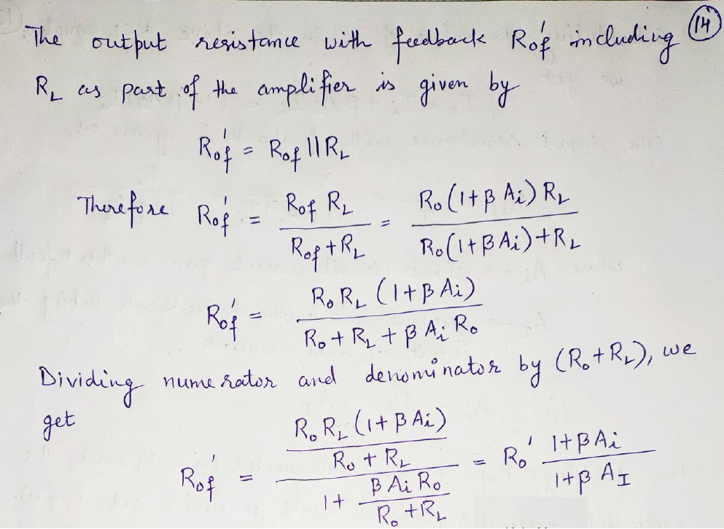

Slide 11
